Slide 1

Analysis of Airline Passengers’ Satisfaction
misy225丨final project
Reporter：Yumiao Li(42054025)
Ziyu Chen(42054017)
2022.11.2

Slide 2


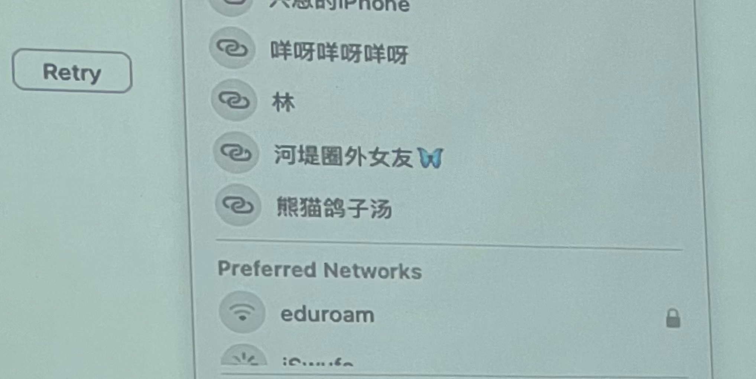

1
Intro
Intro
Dataset
Problem
Solving
App
demo

Slide 3


2
Dataset
The dataset is derived from Kaggle for the sake of exploring factors that affect air passengers’ satisfaction
https://www.kaggle.com/datasets/teejmahal20/airline-passenger-satisfaction
Mainly two parts
Basic information of passengers (9 columns)
Criteria of passengers’ satisfaction (14 columns)
Advantage and Rationality
High Kaggle Usability: 9.41
Standardized and tidy：content for data description/ no comment varibles
Convenient for further prediction：with label for machine learning
Intro
Dataset
Problems
Solving
App
Demo

Slide 4
3
Problems Solving
Problems raised to solve
Find the factors which significantly influence the passengers’ satisfaction.
We use the ‘value_counts’ to see whether there is a huge difference between the types of a factor. If the satisfaction of a factor is distinct, it indicates that the factor is influential to the passengers’ satisfaction. Otherwise, it is not very important.
2. Analyze the relationships between the 14 criteria of satisfaction in the survey and therefore the relationship with the passengers’ satisfaction.
We want to know what aspects of satisfaction is highly correlated so that we can help the company or the entire industry to focus on some details to improve the passengers’ satisfaction.
The answers to these questions will be shown in the data app.
Intro
Dataset
Probelms
Soving
App
Demo

Slide 5
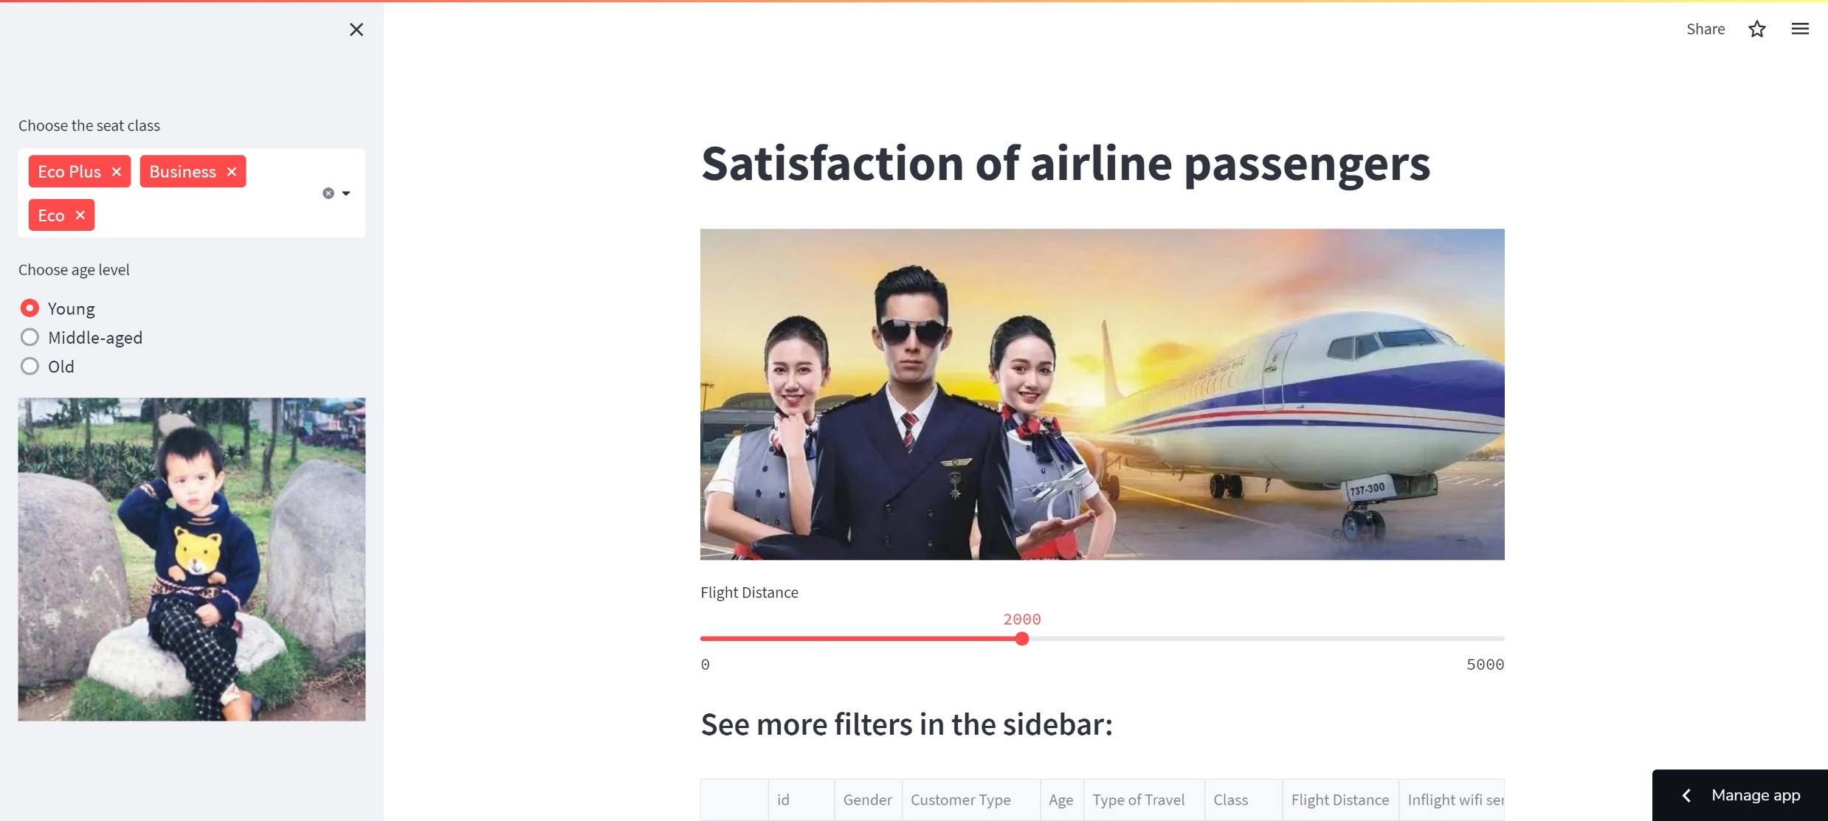
4
App demo
Streamlit: https://justina1220-final-project-app-satisfaction-jbv6wu.streamlitapp.com/
Intro
Dataset
Problems
Solving
App
demo

Slide 6
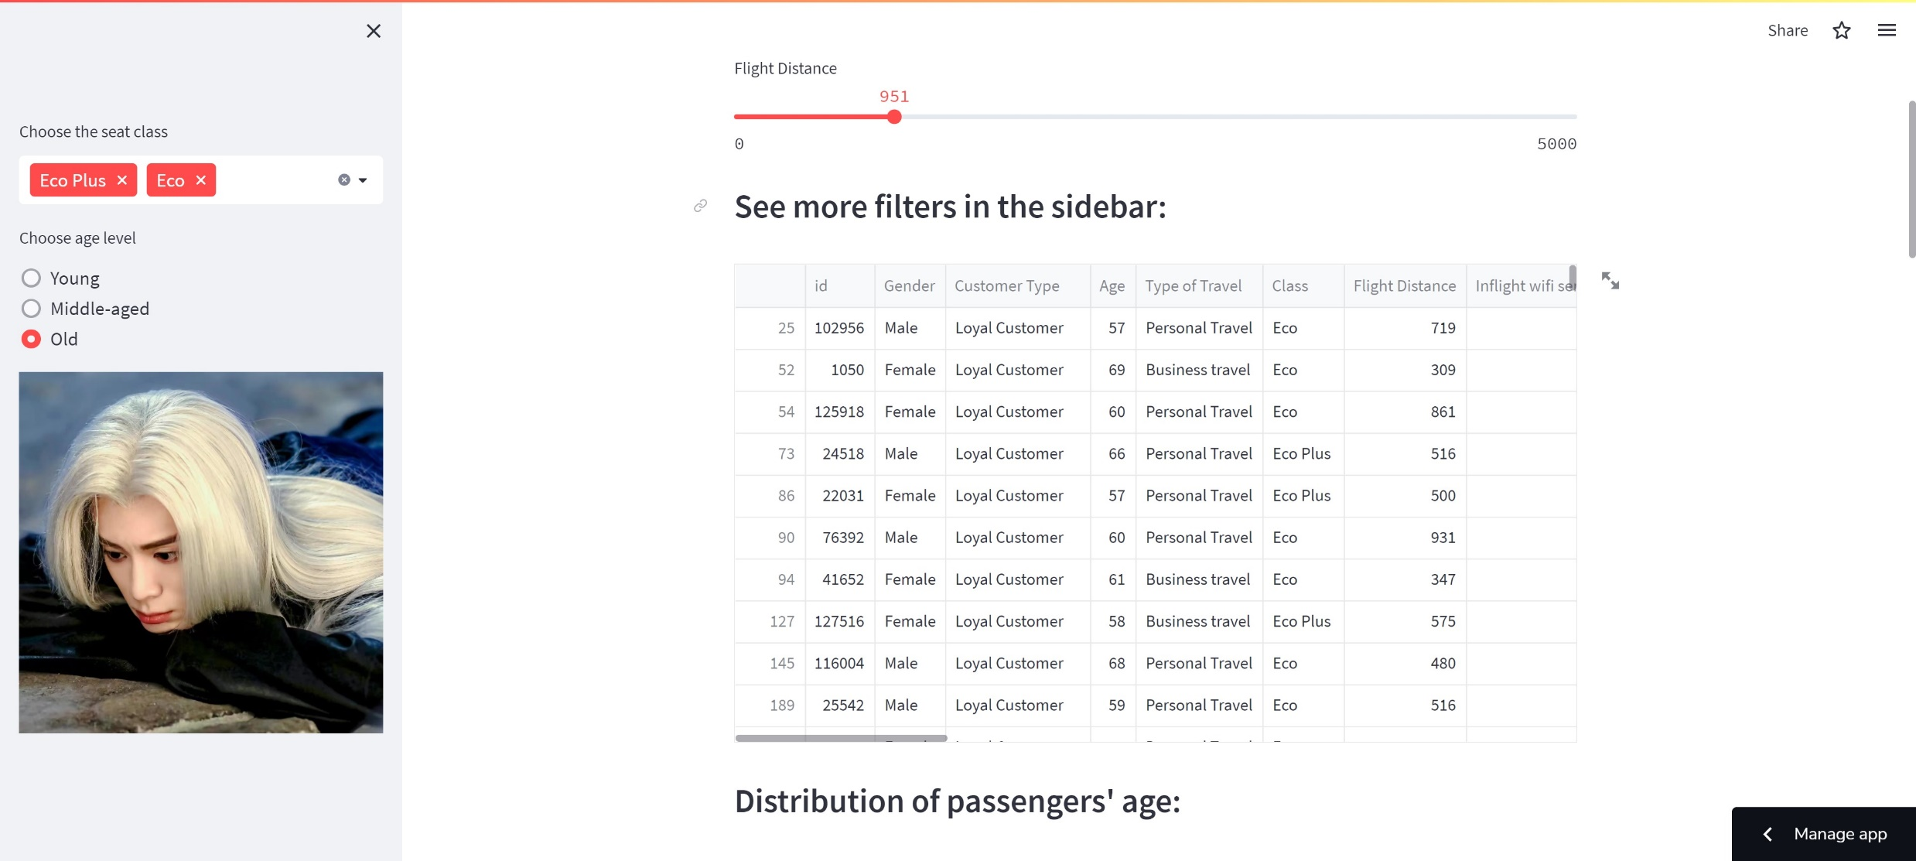
4
App demo
A slider for selecting the upper bound of flight distance
Intro
A single and a multi select
Dataset
Problems
Solving
App
demo

Slide 7
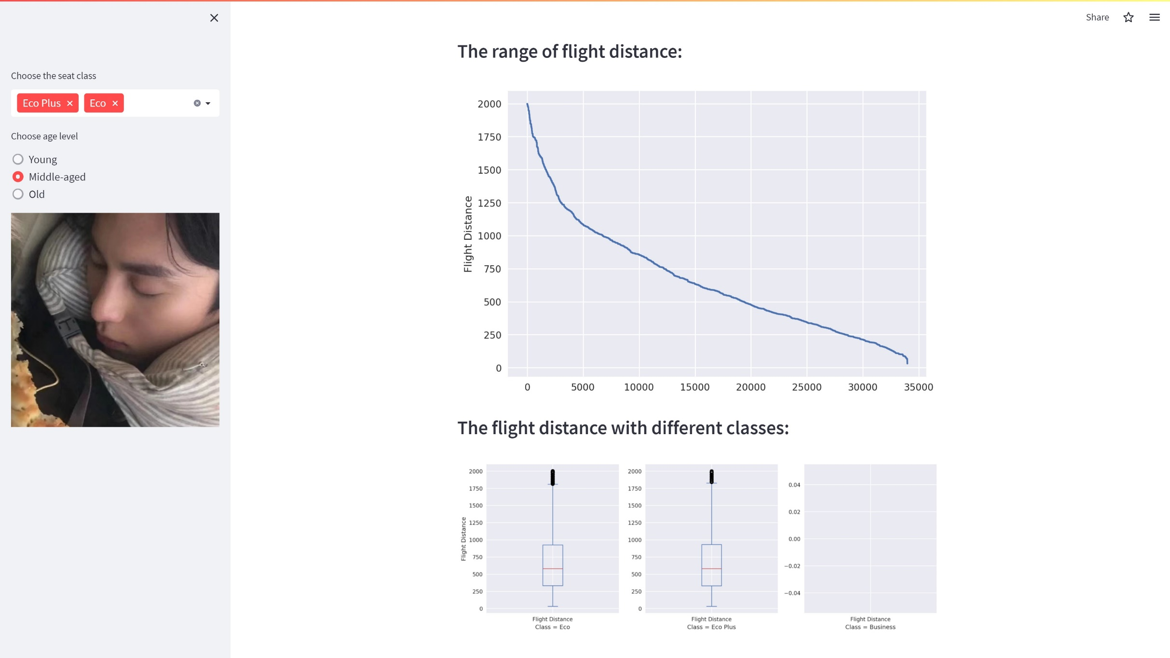
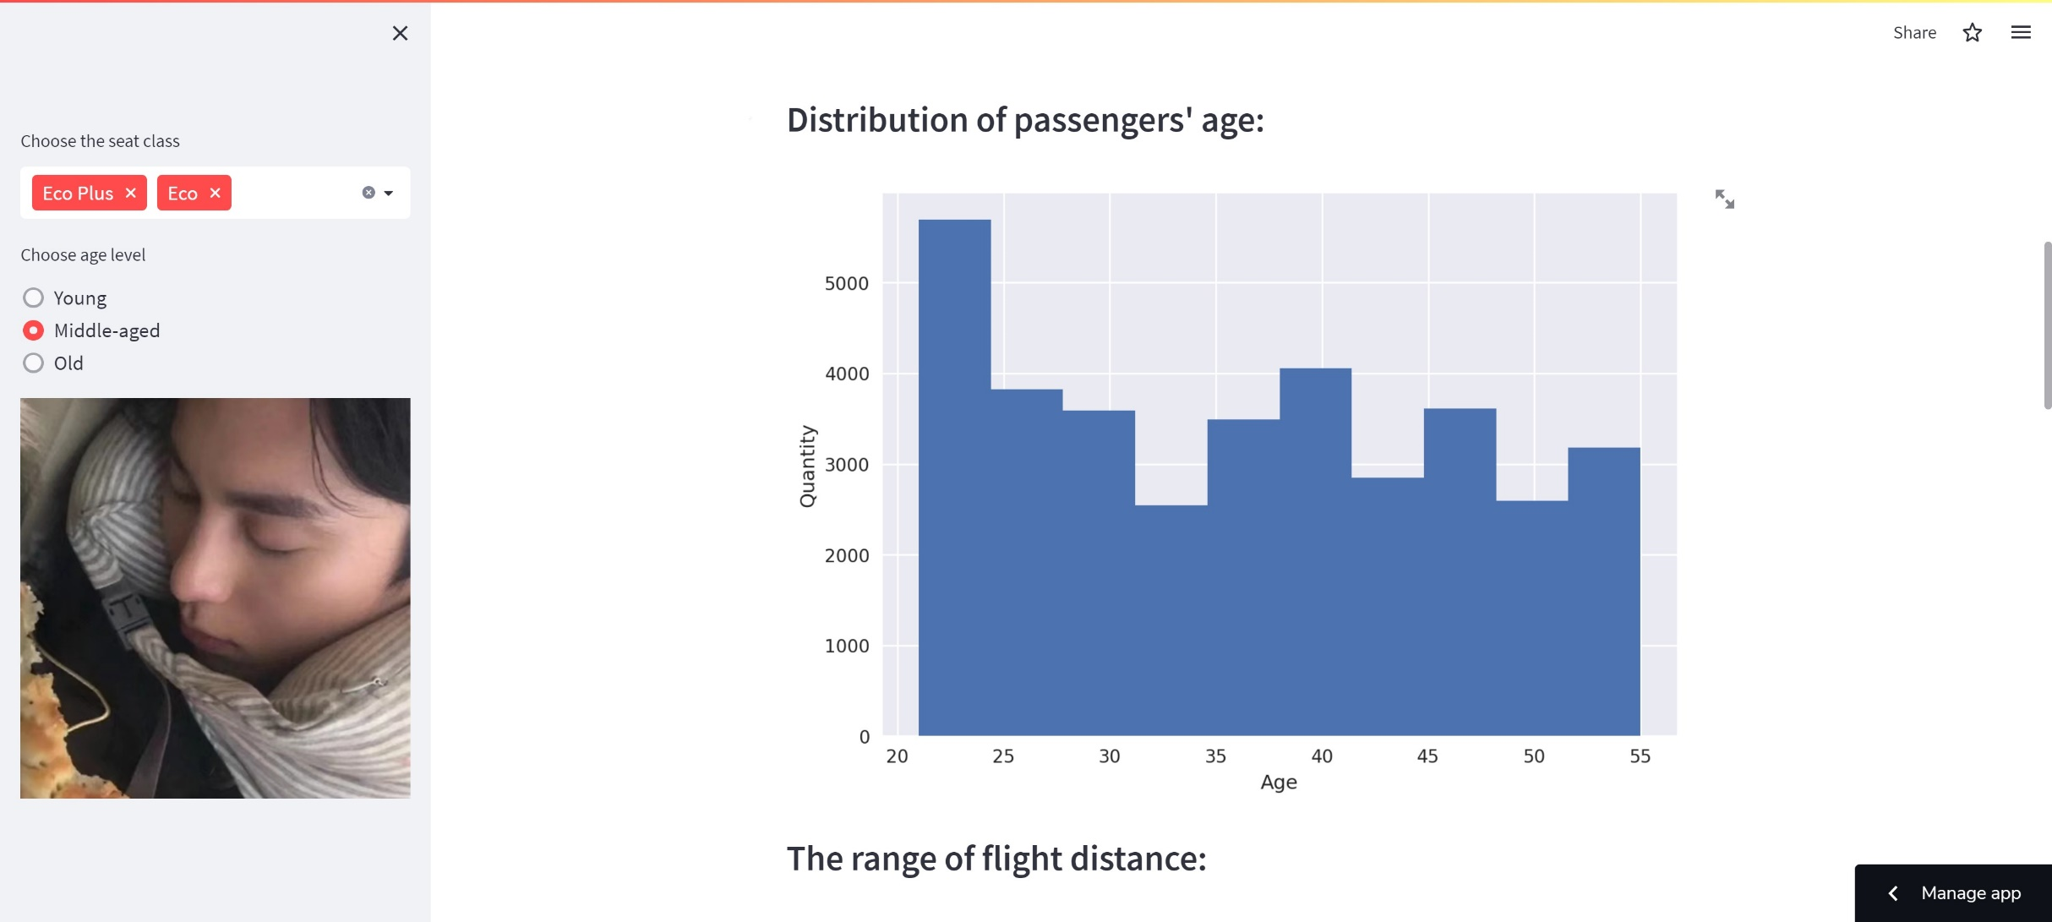
4
App demo
Line chart of the range of flight distance
Box plots of the flight distance with different classes
Histogram of the passengers’ age
Intro
Dataset
Problems
Solving
App
demo

Slide 8
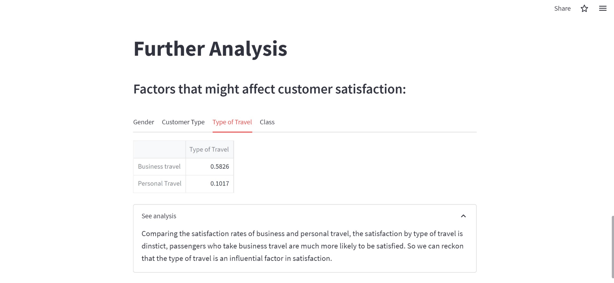
4
App demo
Answers for the problems raised
Intro
Dataset
Problems
Solving
Choose the different factors
App
demo
See the specific explanation for whether the factor significantly influence the satisfaction or not.
The last three factors are influential while the ‘Gender’ is not distinct.

Slide 9
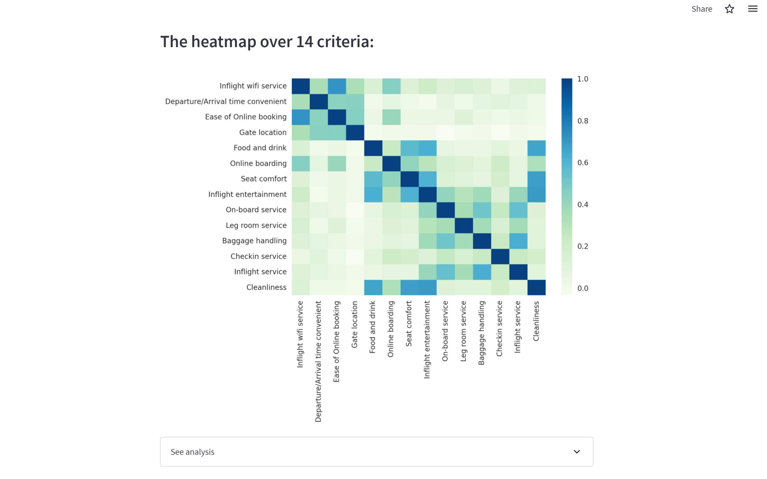
4
App demo
Heatmap of 14 variables
The legend indicates that the correlation between the criteria will increase as the color becomes deeper.
Intro
Dataset
Problems
Solving
App
demo
See the specific explanation that the criteria ‘Cleanliness’, ‘Food and drink’, ‘Seat comfort’, ‘Inflight entertainment’ are highly associated.

Slide 10
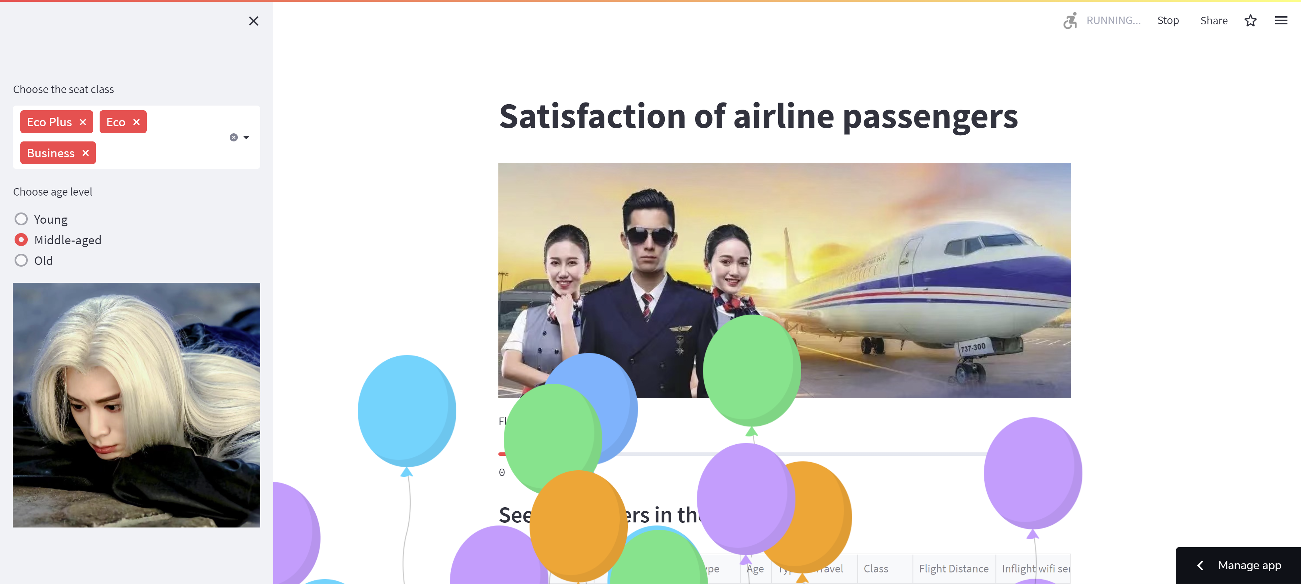
4
App demo
Bonus Scene: 彩蛋
If you select correctly, there will be some balloons flying upwards to cheer for you success.
Intro
Dataset
Problems
Solving
App
demo

Slide 11
Thanks for watching
misy225丨final project

